Slide 1
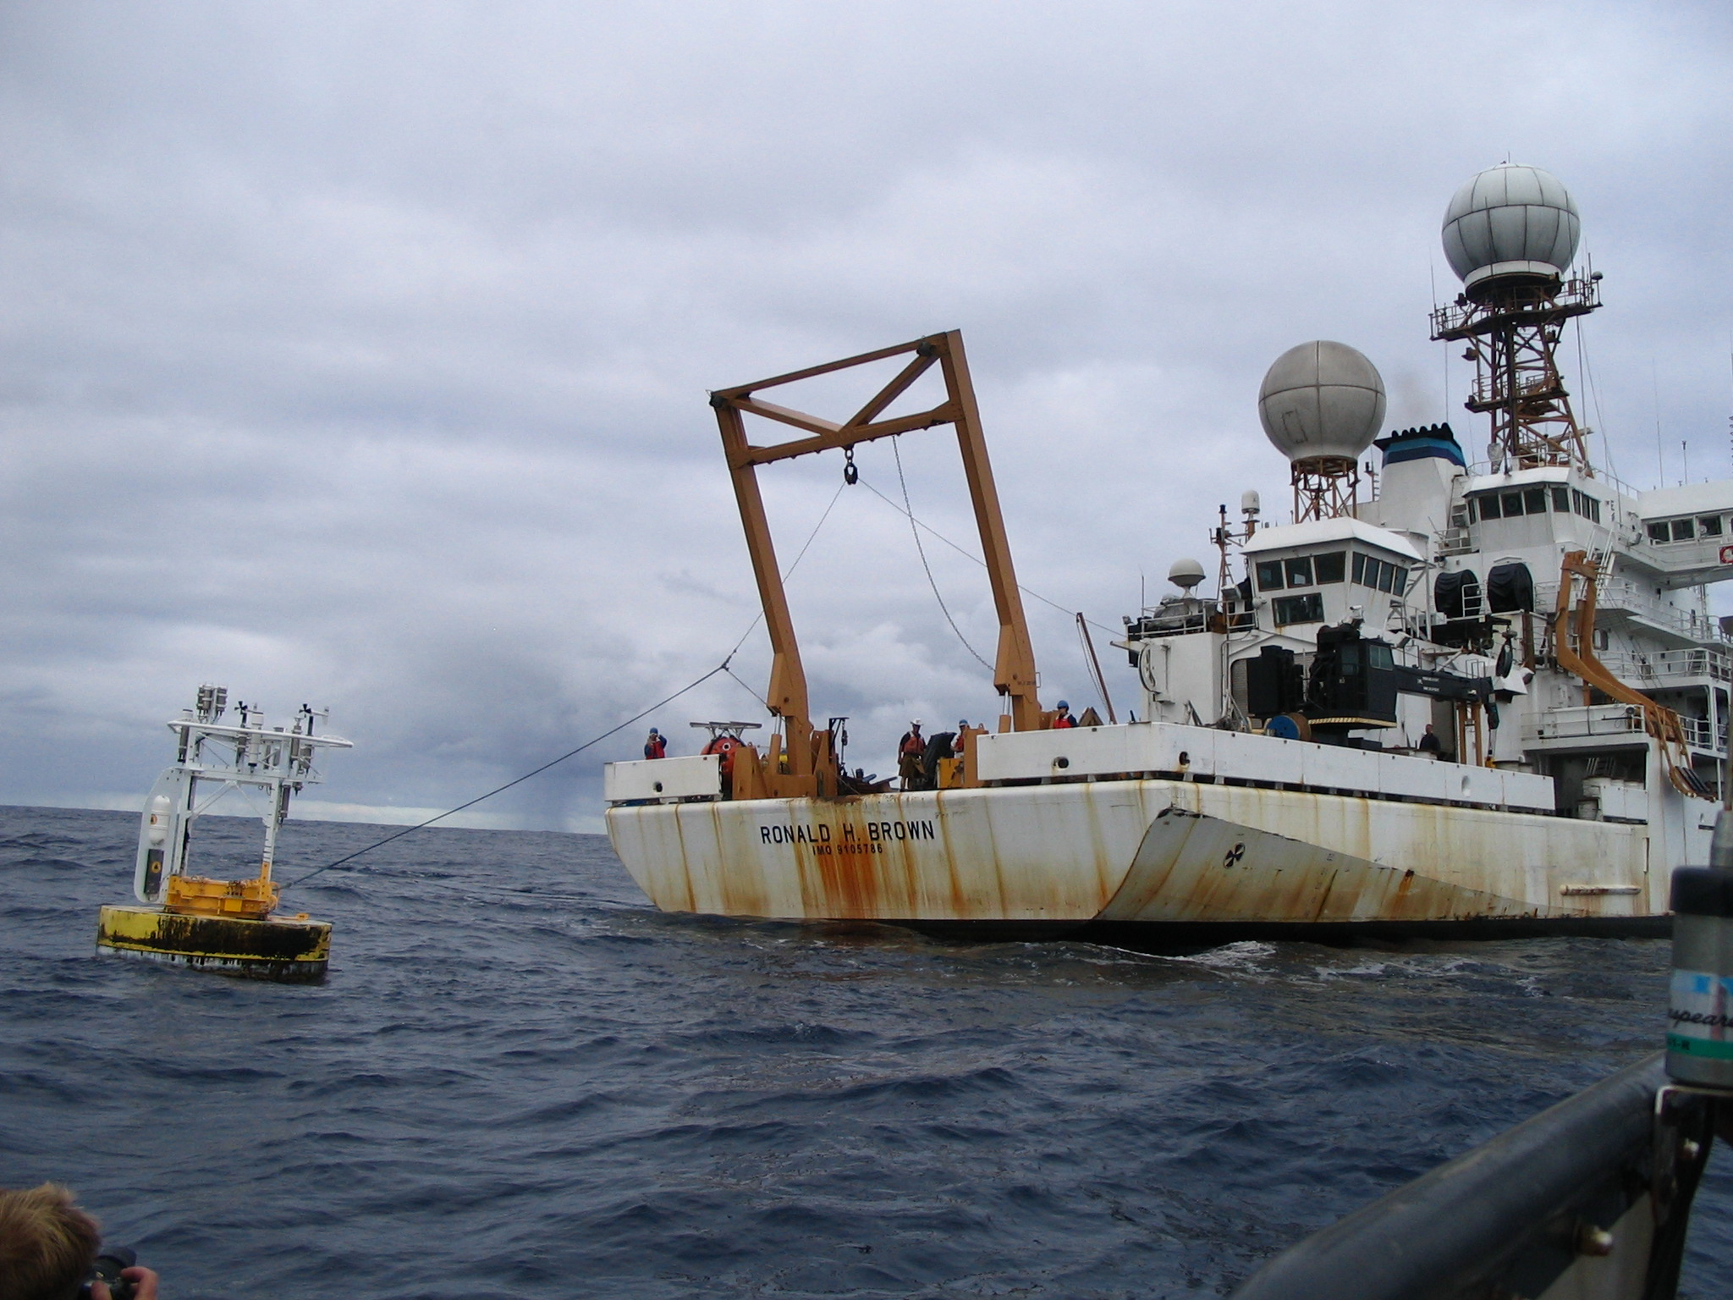
Ocean Reference Stations:
Highlights from the Stratus ORS
Robert Weller
WHOI
rweller@whoi.edu http://uop.whoi.edu

Slide 2
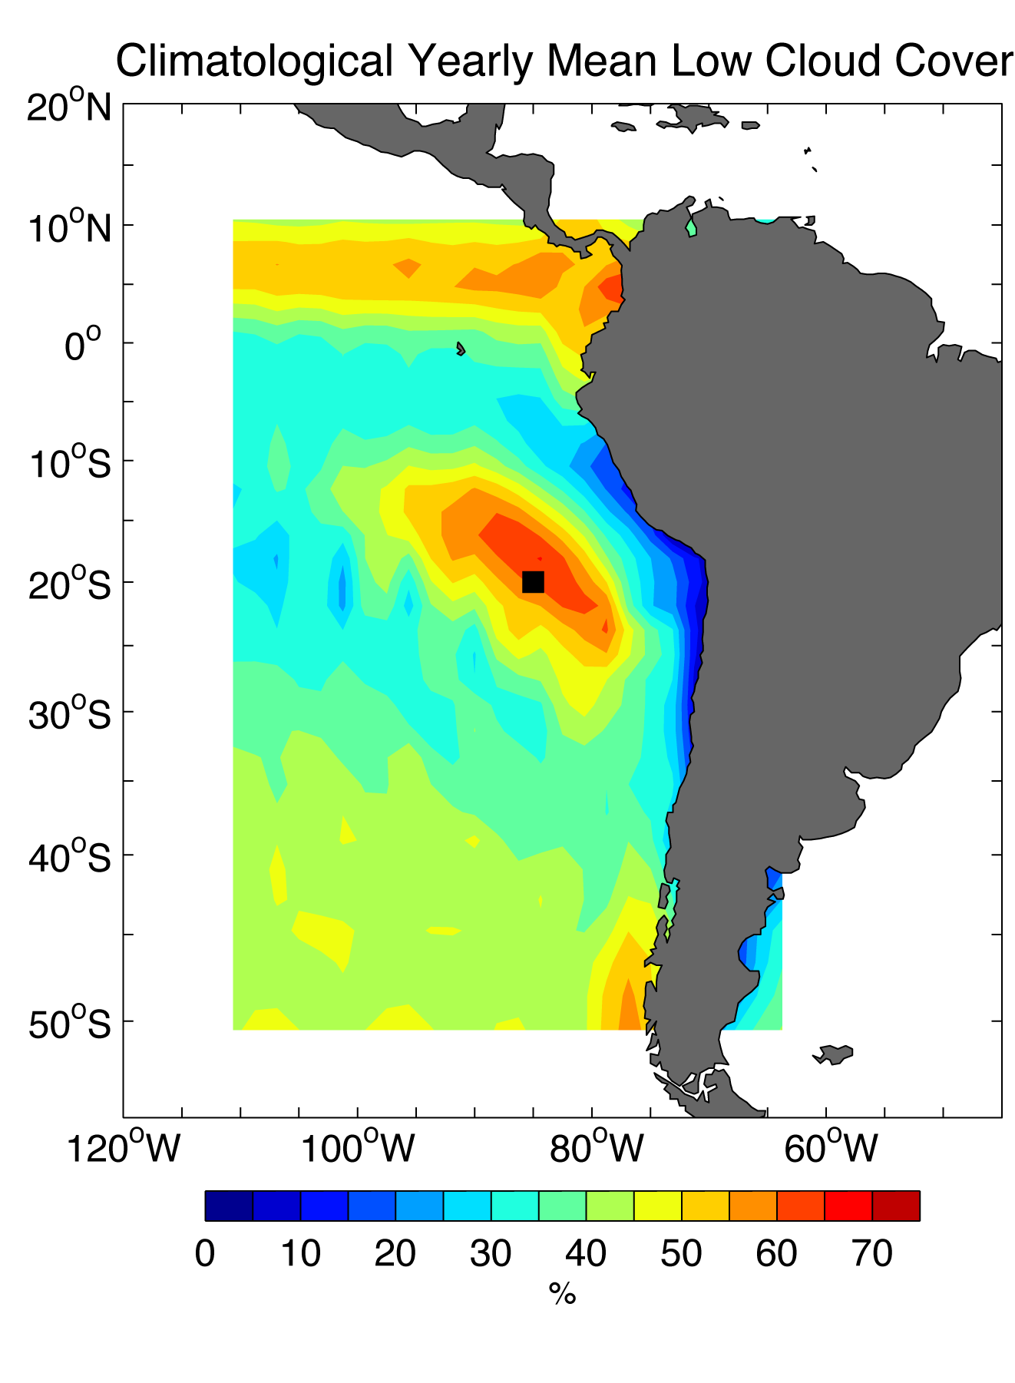
The motivation – improve understanding and model representation of processes that may yield predictive skill
Questions:
What processes promote and sustain marine stratus clouds?
What sets SST here? What is the upper ocean heat budget?
What are the air-sea exchanges of heat, freshwater, and momentum?
The eastern South Pacific is not warming – why not?
Are the state, variability, and trends in the trade wind regions well-modeled?

Slide 3
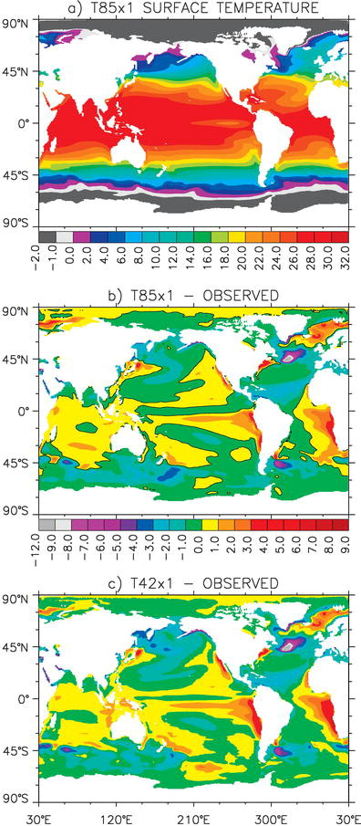
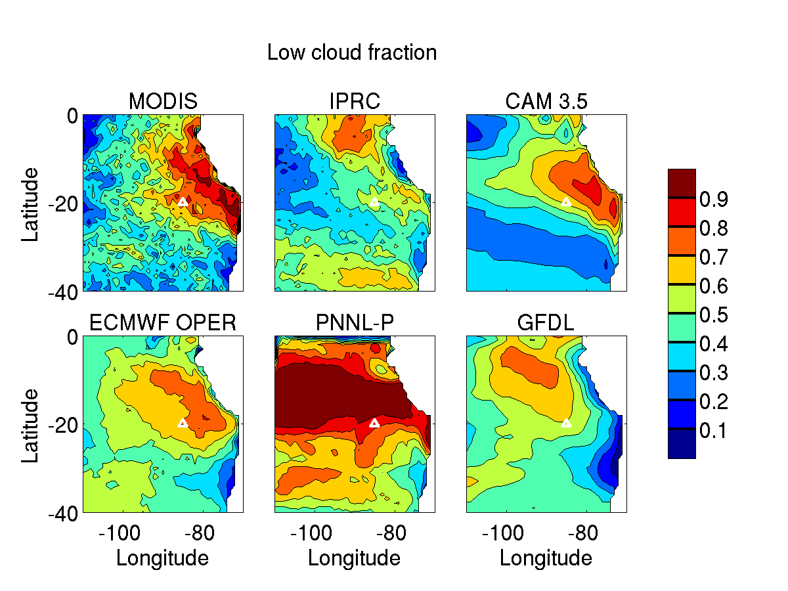
The motivation – improve understanding and model representation of processes that may yield predictive skill; an impediment – large model biases
Comparisons of the Community Climate System Model 3 (CCSM3) with observations by Large and Danabasoglu (2006). Model SST, in particular, is too warm in the stratus deck region.
Wyant et al (2010) found models also had difficulty reproducing the stratus cloud deck.

Slide 4
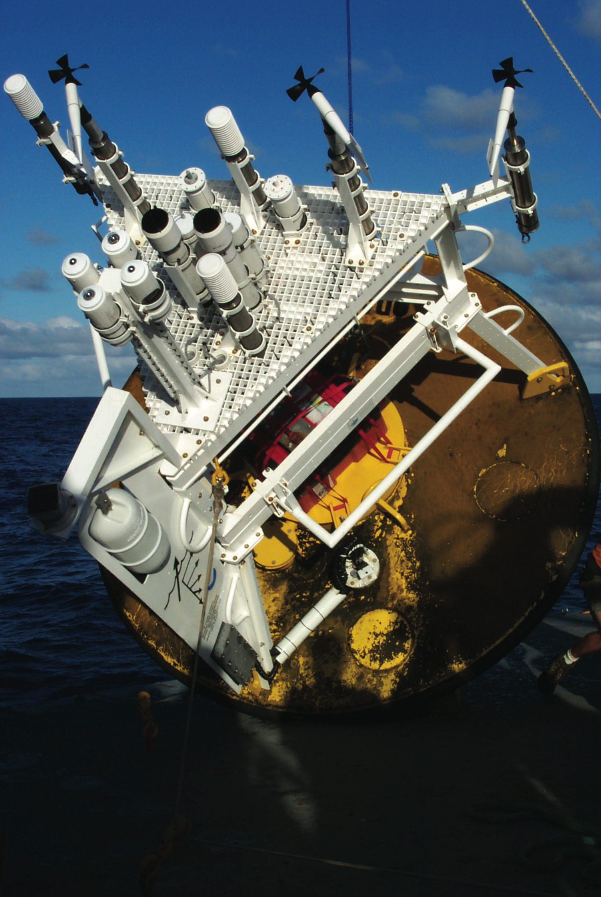
Routine deployments of up to 12 months,
Two to three redundant sets of bulk meteorological sensors, with typical yield of 100% return of a complete 1-minute set of time series.
Anemometers
RH/AT
BP
 | Instant | Daily | Monthly
Incoming Longwave | 7.5 W m⁻² | 4 W m⁻² | 4 W m⁻²
Incoming Shortwave | 10 W m⁻² | 6 W m⁻² | 5 W m⁻²
Relative humidity | 1% RH, 3% low wind | 1%, 3% low wind | 1%
Air temperature | 0.2° | 0.1° | 0.1°
Barometric pressure | 0.3 mb | 0.2 mb | 0.2 mb
SST | 0.1° | 0.1° | 0.04°C
Wind speed | 1.5% 0.1 m s⁻¹ | 1% 0.1 m s⁻¹ | 1% 0.1 m s⁻¹
Wind direction | 6° | 5° | 5°
Precipitation | 20% | 20% | 20%
SW/LW
Rain

Slide 5
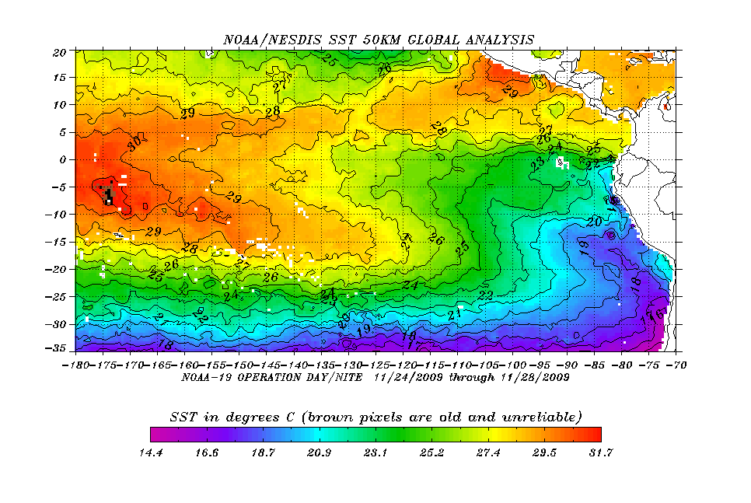
The setting - the Southeast Pacific trade wind regime
Persistent trade winds, coastal upwelling.
Trade winds – directionally steady
Lower level of synoptic weather systems

Slide 6
Establishing the context from a model? Which model? Are the models realistic?
ERA: 0.0014 N m⁻² yr⁻¹
NCEP2: 0.0009 N m⁻² yr⁻¹
Buoy: 0.0013 N m⁻² yr⁻¹
ERA: -2.7 W m⁻² yr⁻¹
NCEP2: -0.8 W m⁻² yr⁻¹
Buoy: -1.5 W m⁻² yr⁻¹

Slide 7
ERA I
10 m wind trends
Thanks to
Kent Moore
U. Toronto
1979-2013
10 m wind trend
m s⁻¹/decade
Color indicates statistically significant
1986-1999
2000-2013

Slide 8
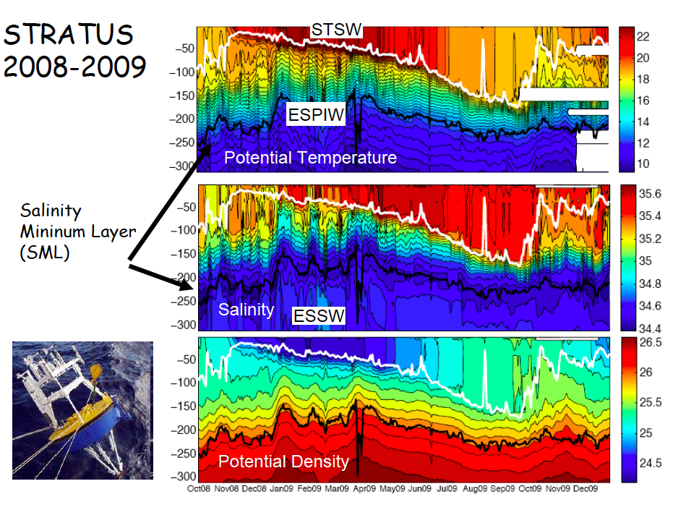
The setting – shallow, salty, surface layer; cool, fresh mode water below; a well-defined annual cycle with a mixed layer going down to ~150m each October
The data from the mooring has shown a cool, fresh mode water (Eastern South Pacific Intermediate Water) underlying the surface layer, with Equatorial Subsurface Water below that.

Slide 9
Deep CTD – Stratus 4 Dec 2004
ESPIW
34.4 psu
12° C

Slide 10
Oxygen contour plot from profiling ARGO float near Stratus ORS, covering ~one year
Very low oxygen
October 2008
October 2009

Slide 12
Strong eddy variability at and below mixed layer base

Slide 13
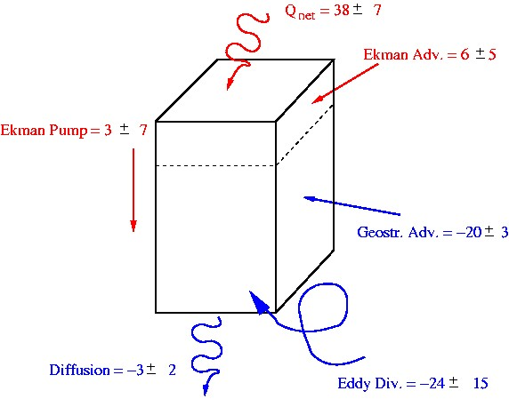
How are upper ocean budgets changing as surface forcing changes?
Low salinity AAIW
Top of O₂ min layer
Geostrophic advection from SW - heat, salt
Eddy flux from the coast - heat, salt, nutrients
Vertical mixing between upper thermocline and surface mixed layer
Vertical exchange between surface layer and oxygen minimum layer

Slide 14
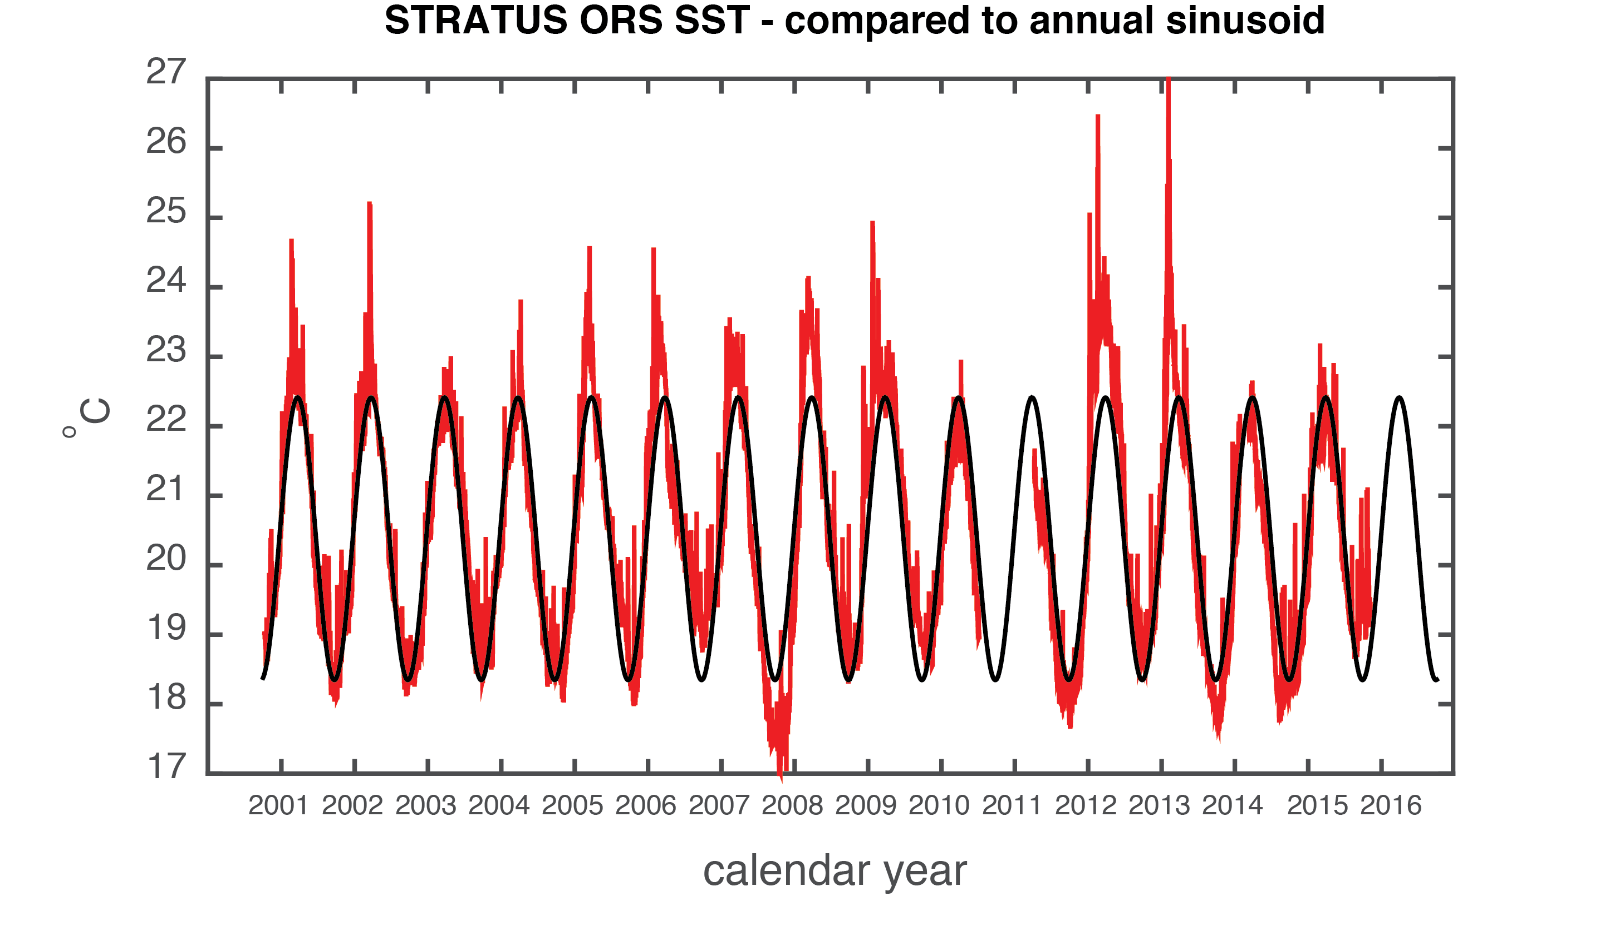
Complex demodulation fails to show change in either phase or amplitude of SST over the 15 years - this had lead us to investigate the role of diurnal warming in controlling SST

Slide 15
Wind stress dies over a broad are of the eastern South Pacific
SLP/Wind Jan 3, 2007
At times, the South Pacific high pressure cell shifts and a broad area of low wind is established.
H
SLP/Wind Jan 18, 2007
H

Slide 16
Stratus – key points
Withheld, high quality benchmark for atmospheric, oceanic, coupled models
Record length is key to statistical significance of trends
New insights into the role of high frequencies in surface forcing in maintaining lower frequency state
Decadal, multidecadal signals a challenge – PDO now changing sign so will Stratus surface forcing change
Adapted to findings by adding deeper T/S sensors
Adding dissolved oxygen, biological sensors to better investigate role of eddies

